Slide 1
Final Engagement
Attack, Defense & Analysis of a Vulnerable Network

Slide 2
Table of Contents
This document contains the following resources:
Network Topology & Critical Vulnerabilities
Traffic Profile
Normal Activity
Malicious Activity

Slide 3
Network Topology
& Critical Vulnerabilities
‹#›

Slide 4
Network Topology
[Insert Here]
Use draw.io to create a diagram of the network.
Add your diagram to this slide and fill out the data in the sidebar.
Network
Address Range:
Netmask:
Gateway:
Machines
IPv4:
OS:
Hostname:
IPv4:
OS:
Hostname:
IPv4:
OS:
Hostname:
IPv4:
OS:
Hostname:

Slide 5
Critical Vulnerabilities: Target 1
Our assessment uncovered the following critical vulnerabilities in Target 1.
Vulnerability | Description | Impact

Slide 6
Critical Vulnerabilities: Target 2
Our assessment uncovered the following critical vulnerabilities in Target 2.
Vulnerability | Description | Impact

Slide 7
Traffic Profile
‹#›

Slide 8
Traffic Profile
Our analysis identified the following characteristics of the traffic on the network:
Feature | Value | Description
Top Talkers (IP Addresses) | 172.16.4.205 166.62.111.64 10.0.0.201 | Machines that sent the most traffic.
Most Common Protocols | Packets / Bytes TCP 88.5% / 89.6% UDP 11.0% / 0.1% | Three most common protocols on the network.
# of Unique IP Addresses | 808 IPv4 | Count of observed IP addresses.
Subnets | 10.0.0.0/24 10.6.12.0/24 172.16.4.0/24 | Observed subnet ranges.
# of Malware Species | 1 - june11.dll (Trojan) | Number of malware binaries identified in traffic.
Notes:
You may have more than 2 subnets.

Slide 9
Behavioral Analysis
Purpose of Traffic on the Network
Users were observed engaging in the following kinds of activity.
“Normal” Activity
Browsing the web
Watching Youtube
Suspicious Activity
Malware Infection
Illegal file downloads

Slide 10
Normal Activity
‹#›

Slide 11
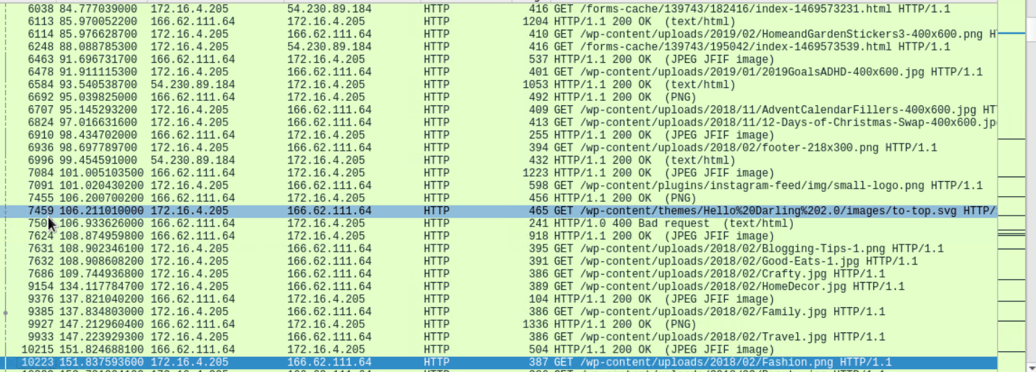
Browsing the Web
Normal usage, browsing a wordpress framework based website.
Norman use of HTTP

Slide 12
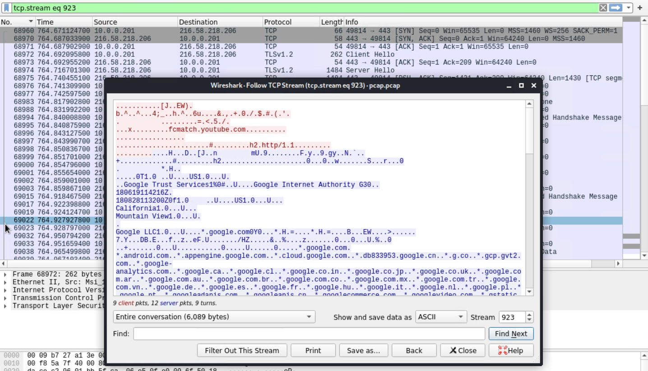
Watching Youtube
TCP and TLS traffic to YouTube.com

Slide 13
Malicious Activity
‹#›

Slide 14
Malware Infection
TCP and TLS traffic to YouTube.com

Slide 15
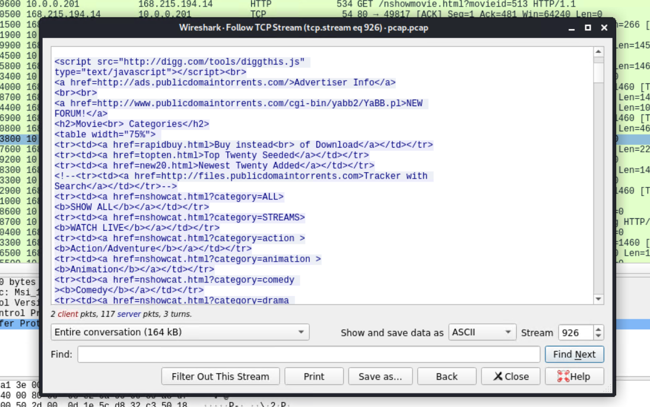
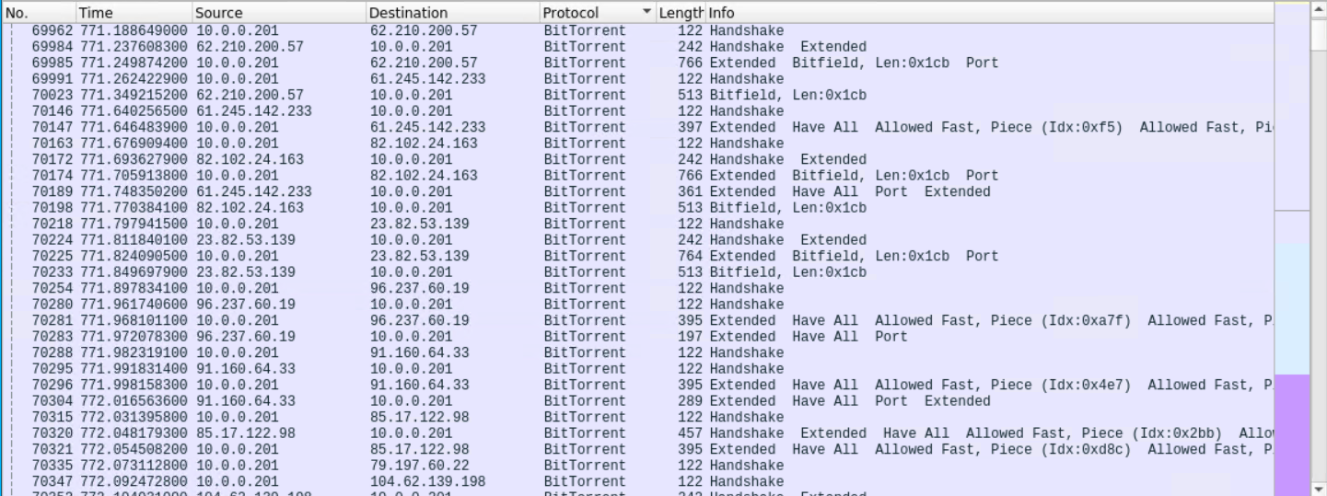
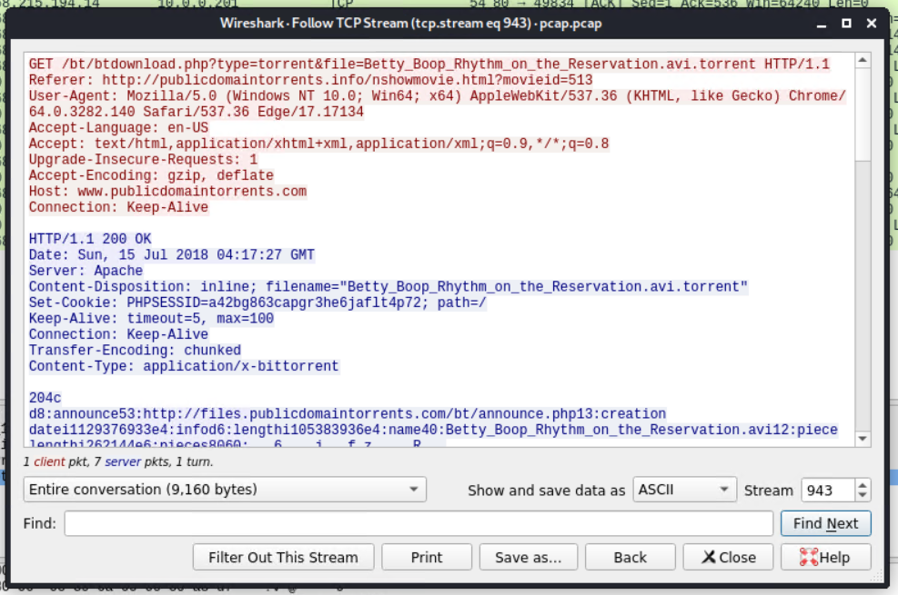
Illegal File Downloads
Browsing for copyright material on public bittorrent tracker
Downloading and fetching torrent data

Slide 16
The End
‹#›

